Slide 1
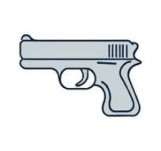
PPSB Firearms Training

Slide 2
Training Objectives
Discuss the provision of NCGS 74C as it pertains to the armed security officer.
Describe in writing and demonstrate the proper methods for cleaning and inspecting the service handgun.
Demonstrate the ability to quickly but safely draw a handgun and/or shoulder a shotgun (shotgun training only)
Attain a qualifying score of at least 80 percent accuracy on the approved courses of fire.
.

Slide 3
Training Objectives
Demonstrate 2 methods of utilizing the flashlight while firing the handgun.
Describe in writing the difference between cover and concealment.
Describe in writing sight alignment and sight picture.
List the four (4) functional tasks that the security officer must be able to perform under low light conditions.
Demonstrate how to combat load the shotgun (Shotgun training only)
Explain the color code system of Mental Conditioning.
Demonstrate how to safely secure a handgun.

Slide 4
PPSB Legal Issues
Training Objectives
Discuss “Justified Self-Defense.”
Discuss when an armed security officer may use deadly force.
List five areas where the carrying of a concealed weapon is prohibited.
Discuss the provisions of N.C General Statute 74C as it pertains to an armed security officer.
Discuss the training requirements of an armed security officer.

Slide 5
Justified Self-Defense
The person actually believes that deadly force is necessary to prevent an imminent threat of death, great bodily harm, or sexual assault, and
The facts and circumstances prompting that belief would cause a person of ordinary firmness to agree, and
The person using deadly force was not an instigator or aggressor who voluntarily provoked, entered, or continued the conflict leading to deadly force, and
Force was not excessive…greater than reasonably needed to overcome the threat posed by a hostile aggressor.

Slide 6
Protection of Property
Under NO Circumstances can DEADLY FORCE Be used to PROTECT PROPERTY.
Deadly Force CANNOT be used to stop a THIEF
Before, During, or After the Theft!!!

Slide 7
ABILITY
OPPORTUNITY
JEOPARDY
Required Factors for an Officer to use force.

Slide 8
Use of Force Continuum
Presence
Verbal
Soft Hand Control
Hard Hand Control
Chemical
Impact Weapons
Deadly Force

Slide 9
“Prohibited Carry Areas”
Where Owner Forbids Firearms.
Educational Property.
Assembly Where Admission is Charged.
Where Alcoholic Beverages are Sold AND Consumed if no CCH permit.
Courthouses, State Buildings, and Federal Property.

Slide 10
“Prohibited Carry Areas”
Parades & Funerals if no CCH permit.
Demonstrations and Picket Lines in certain areas.
Law Enforcement or Correctional Facility.
Anywhere a Conspicuous Sign Has Been Posted.
After Having Consumed Alcohol or Illegal Controlled Substances if CCH permittee.

Slide 11
Safety
Training Objectives
Discuss the provisions of North Carolina General Statute 14-315.1 “Storage of firearms to protect minors.”
List the “Four Cardinal Rules for Safe Gun Handling.”
Demonstrate how to safely store a handgun.

Slide 12
Safety Safety Safety Safety
Think Safe!
Act Safe!
Be Safe!

Slide 13
Four Cardinal Rules For Safe Gun Handling
Treat every weapon as if it were loaded.
Always point the muzzle in a safe direction.
Keep your finger outside the trigger guard until you are ON TARGET and HAVE DECIDED to FIRE!
Be sure of your target and what’s around and beyond it!

Slide 14
Remember !!!!!
ALWAYS
CHECK
the
WEAPON

Slide 15
“Storage of Firearms to Protect Minors”
N.C. General Statute 14-315.1
If the minor gains access to a firearm without the lawful permission of the minor’s parents or a person having charge of the minor, and the minor:
Possesses it on educational property, or
Exhibits it in a public place, or
Causes personal injury or death not in self-defense, or
Uses it in the commission of a crime
The person who owns the firearm may be guilty of a Class 1 Misdemeanor.

Slide 16
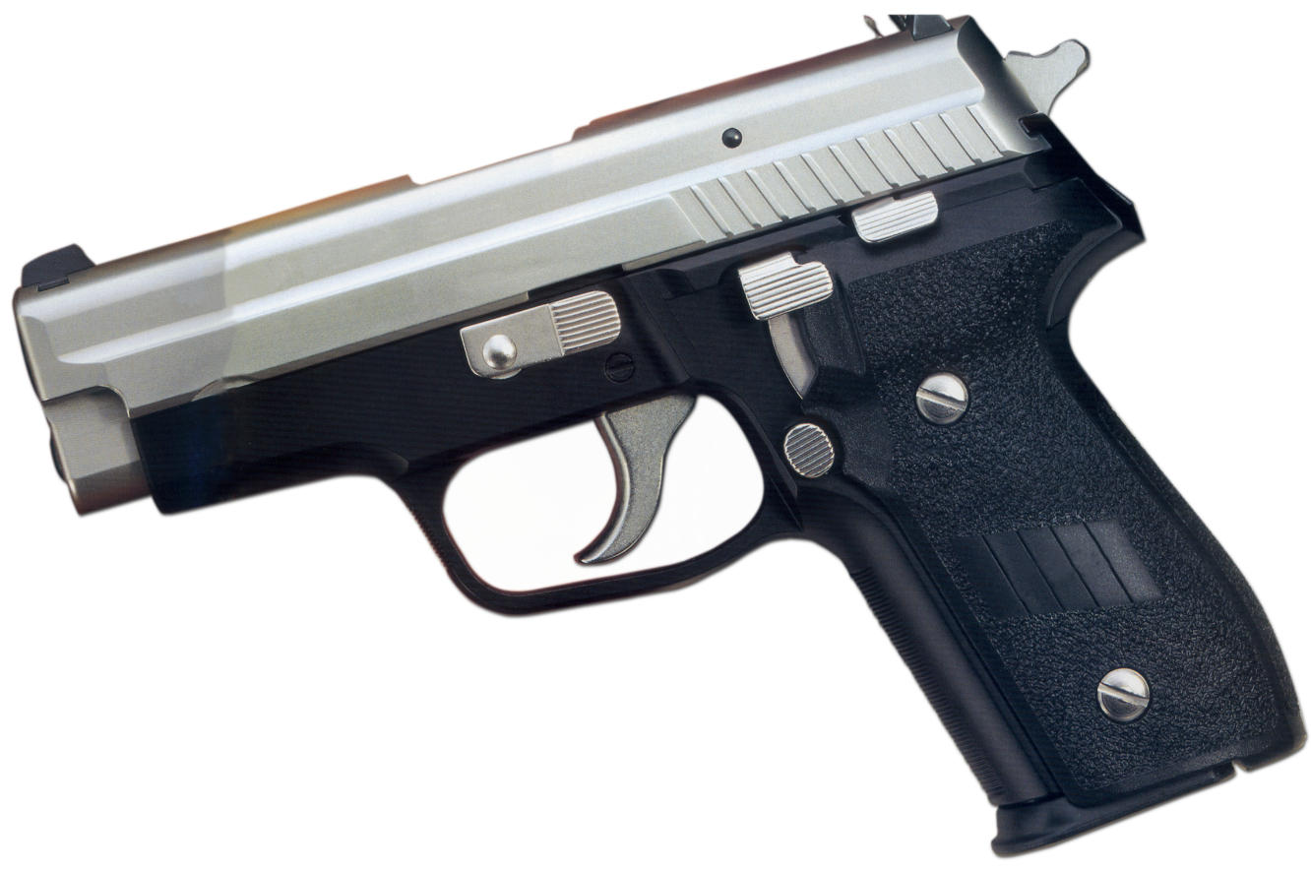
Handgun Operation & Maintenance Training Objectives
Describe the nomenclature of the revolver.
Describe the nomenclature of the semiautomatic handgun.
Demonstrate how to safely load and unload the revolver and semiautomatic handgun.
Describe the cycle of operation of the semiautomatic handgun.
Demonstrate how to clean and inspect the handgun.

Slide 17
Cycle of Operation
Feeding
Chambering
Locking
Firing
Unlocking
Extracting
Ejecting
Cocking

Slide 18
Marksmanship Fundamentals Training Objectives
List the four steps of the draw.
Demonstrate the proper one-hand and two-hand grip.
Demonstrate two stances.
Define Sight Alignment.
Define Sight Picture.
Describe in writing how to perform a malfunction drill.

Slide 19
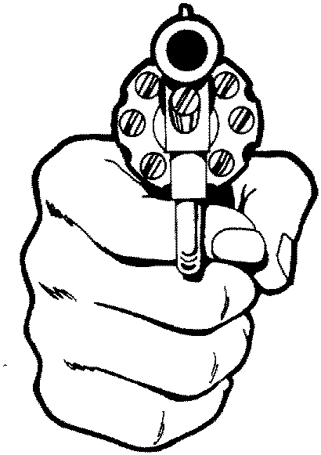
Four Steps to DRAW!
Establish the master grip.
Clear the holster.
Weapon is brought to the center line of the body. Two hands can come together at this point to establish a good two-handed grip.
Extend towards the target.

Slide 20
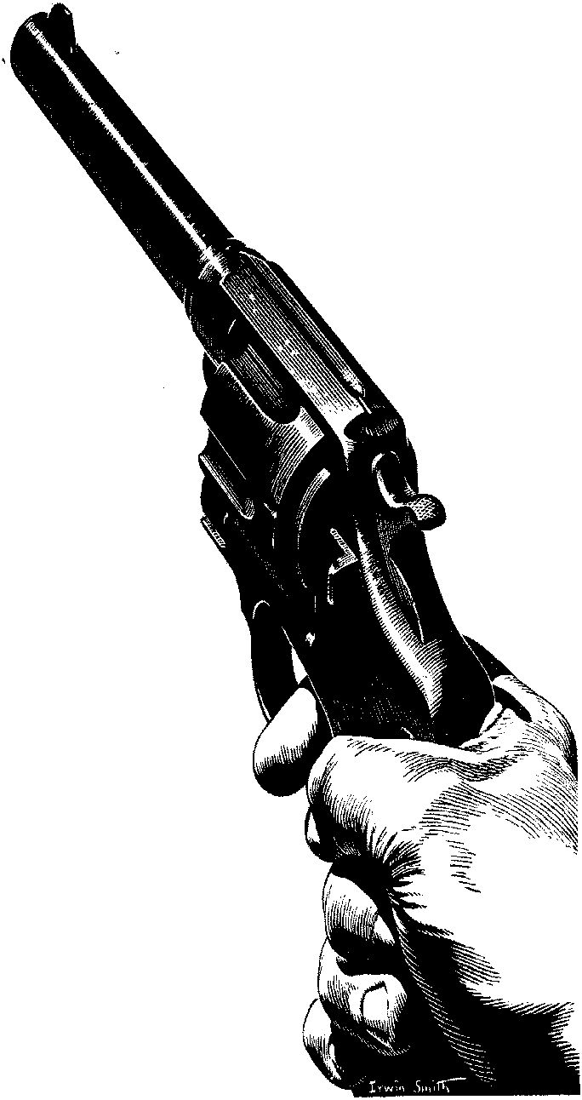
Marksmanship Fundamentals
Grip
Sighting (Alignment & Picture)
Breath Control
Trigger Manipulation
Stance
Follow Through

Slide 21
TAP
RACK
READY

Slide 22
Night Firing Training Objectives
Describe in writing the “Operational Philosophy” of night firing.
Demonstrate two methods of employing the flashlight while firing the handgun.
Successfully complete a night qualification course with a score of 80% or better.

Slide 23

Flashlight Techniques
Harries
Modified Harries
Ayoob
Chapman
Overhand
Stacked Support

Slide 24
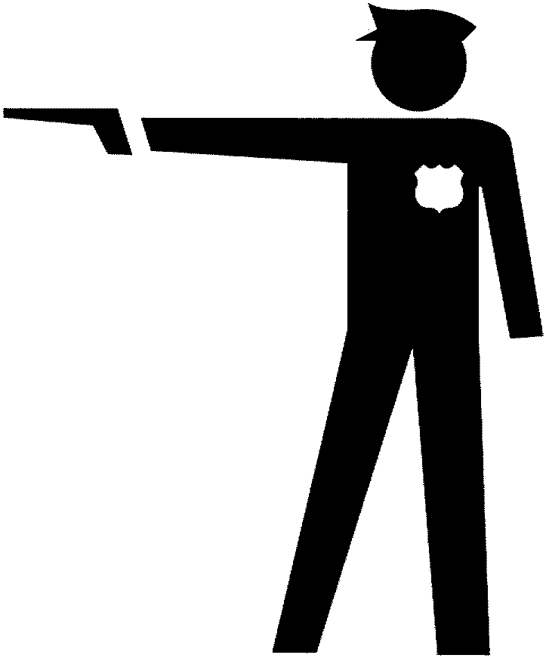
Encounter Techniques Training Objectives
Describe in writing the difference between cover and concealment.
List the four colors of the mental conditioning color code system.
Demonstrate how to fire from behind a barricade.

Slide 25

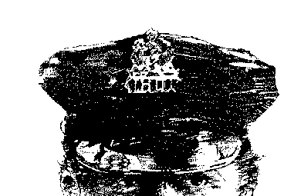
Cover vs. Concealment
Cover PROTECTS!
Concealment Hides!

Slide 26
3 Basics of Survival Shooting
Weapon must be presented quickly!!!
Weapon must be held the same way for each shot!!!
Weapon must be held still while the shot is fired!!!

Slide 27
Mental Conditioning
Condition White
Condition Yellow
Condition Orange
Condition Red

Slide 28
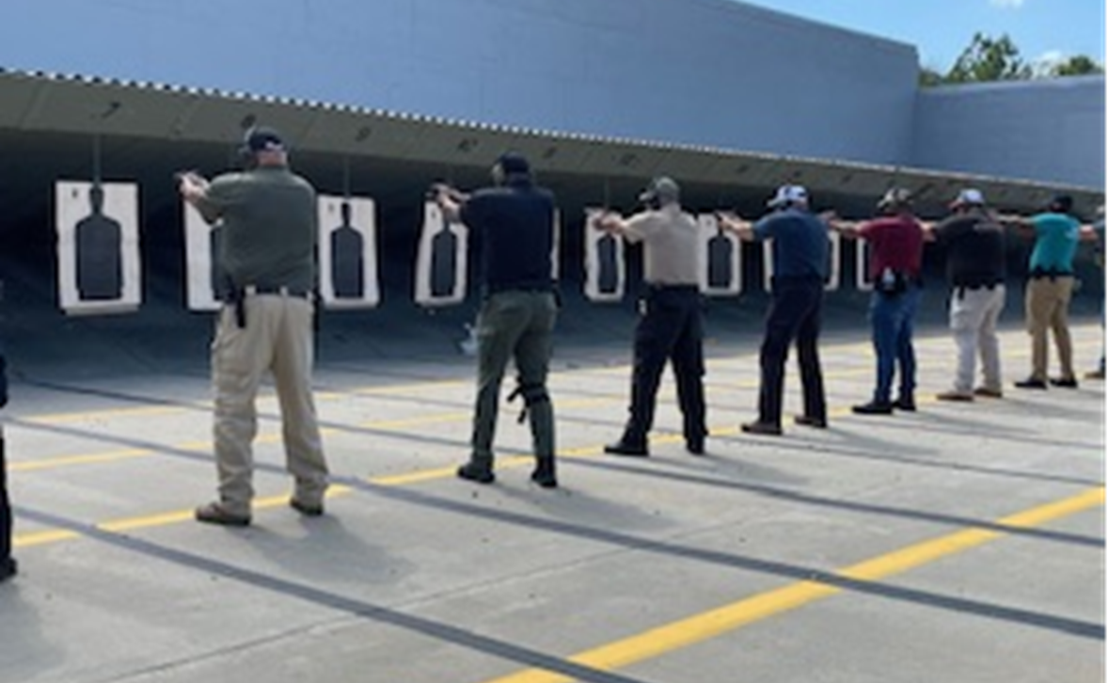
PPSB Courses of Fire

